Slide 1
CS 3281- Operating Systems Inter Process Communication (IPC): Socket

Slide 2
Announcements
Lectures:
https://github.com/cs3281-01/lectures

Slide 3
Inter process communication(IPC)
IPC refers to a set of services/methods provided by the operating system used for exchanging information/messages between processes.
IPC mechanisms can be roughly divided into
Synchronization (semaphores)
Message passing (can be used to exchange information as well as for synchronization)
Shared memory
signals
Shared files.

Slide 4
Review: Inter Process Communication (IPC)

Slide 5
Review: Signal Handler: signal() System Call
int signal(int signum, void (*handler)(int));
First argument is signal number signum, such as SIGINT, SIGSTOP
Second is a reference to a handler function whose first argument is an int and returns void
Example
/* Handle SIGINT with hello *\
signal(SIGINT, hello);
void hello(int signum) {
printf(“Hello World!”);
}

Slide 6
Review: Shared Memory
Creating a Shared Memory Segment
Allocated in byte amounts
Shared Memory Operations
Create (shmget)
Attach (shmat)
Detach (shmdt)
Shared Memory Control
Remove (shmctl)

Slide 7
Review: mamp

Slide 8
File Descriptors
A File Descriptor is a handle provided by the OS when interacting with files
Typically an index into a data structure in kernel memory
Used for all interactions with that file
In UNIX, almost everything is treated like a file – files, pipes, sockets, you name it
Typical ways to interact with a file descriptor:
open – creates a new file descriptor that points to a resource
write – Write a stream of bytes to that resource
Read – Read a stream of bytes from that resource
Close – Indicate you no longer need access to the resource

Slide 9
Purposes of IPC
Data transfer
Sharing data
Event notification
Process control

Slide 10
IPC using Sockets
What if wanted to communicate between processes that have no common ancestor? Answer: sockets
IPC for processes that are not necessarily on the same host.
Sockets use names to refer to one another.
Means of network IO.

Slide 11
What are sockets?
Socket is an abstraction for an end point of communication that can be manipulated with a file descriptor.
It is an abstract object from which messages are sent and received.
Sockets are created within a communication domain just as files are created within a file system.
A communication domain is an abstraction introduced to bundle common properties of processes communicating through sockets. Example: UNIX domain, internet domain.

Slide 12
Sockets and ports
any port
agreed port
socket
socket
message
client
server
other ports
Internet address = 13.12.11.1
Client Port = 12345
Internet address = 13.12.10.2
Server Port = 80

Slide 13
Inter Process Communication
IP address and port number. In IPv4 about 2¹⁶ ports are available for use by user processes.
UDP and TCP abstraction of the above is a socket.
Socket is associated with a protocol.
IPC is transmitting a message between a socket in one process to a socket in another process.
Messages sent to particular IP and port# can be received by the process whose socket is associated with that IP and port#.
Processes cannot share ports with other processes within the computer. Can receive messages on different ports.

Slide 14





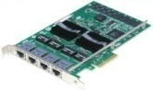
Review: OS Support for Networking
Maps here
Application
Application
Application
Network
Application Layer
HTTP
Operating System
Transport Layer
TCP
Network Layer
IP
Hardware
Data Link Layer
Ethernet
Physical Layer
Ethernet Driver
Network Interface Card
Maps here

Slide 15
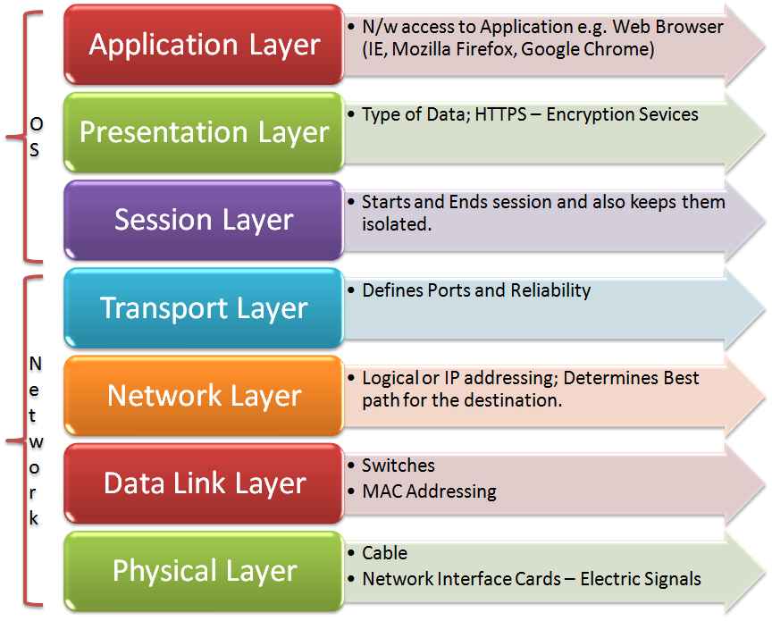
The Open Systems Interconnection model
Challenge: Create a portable interface that will work with all computers/OS/Physical Medium
The message sent by the application has to pass through a 7 layer model.

Slide 16
The Open Systems Interconnection model
Challenge: Create a portable interface that will work with all computers/OS/Physical Medium
The message sent by the application has to pass through a 7 layer model.
Request
Client
Server
Response

Slide 17
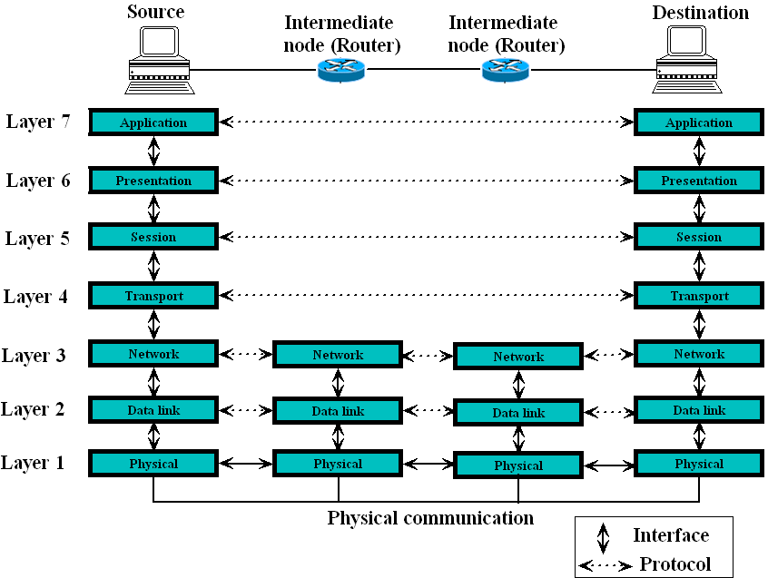
Interaction between layers in OSI

Slide 18

The Open Systems Interconnection model
Challenge: Create a portable interface that will work with all computers/OS/Physical Medium
The message sent by the application has to pass through a 7 layer model.
Client
Server
Socket Interface In Kernel
Socket Interface In Kernel
Network Module
Protocol
Network Module
Protocol
IP Packet
IP Packet
Ethernet Packet
Ethernet Packet
Physical Network
Ethernet frame

Slide 19
Network Protocol
The Transport Layer mechanism.
TCP – transmission control protocol
Receiver is throttled if the server cannot handle the message rate
Message delivery is guaranteed
UDP
Client
Server
Socket Interface In Kernel
Socket Interface In Kernel
Network Module
Protocol
Network Module
Protocol
IP Packet
IP Packet
Ethernet Packet
Ethernet Packet
Physical Network
Ethernet frame

Slide 20
Network Protocol
The Transport Layer mechanism.
TCP – transmission control protocol
UDP – user datagram protocol
Stateless
Fire and forget
Unreliable
Client
Server
Socket Interface In Kernel
Socket Interface In Kernel
Network Module
Protocol
Network Module
Protocol
IP Packet
IP Packet
Ethernet Packet
Ethernet Packet
Physical Network
Ethernet frame

Slide 21
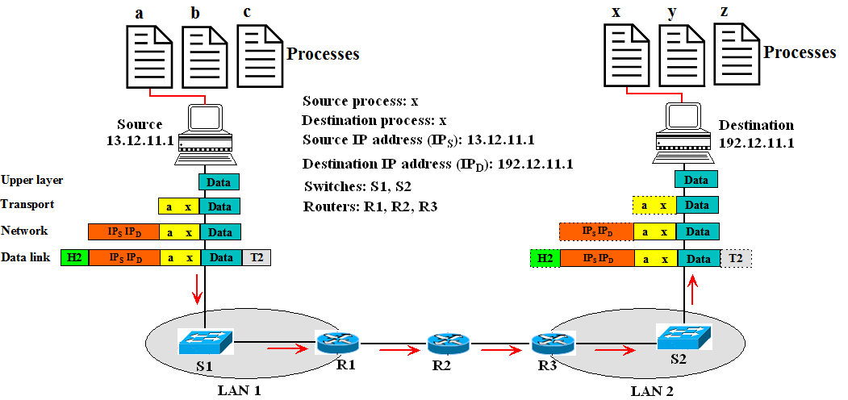
Port Address
Figure shows two computers communicating. The sending computer is running three processes at this time with port addresses a, b, and c. The receiving computer is also running three processes at this time with port addresses x, y and j. Process a in the sending computer needs to communicate with process x in the receiving computer. Note that although physical addresses change from hop to hop, logical and port addresses remain the same from the source to destination.

Slide 22
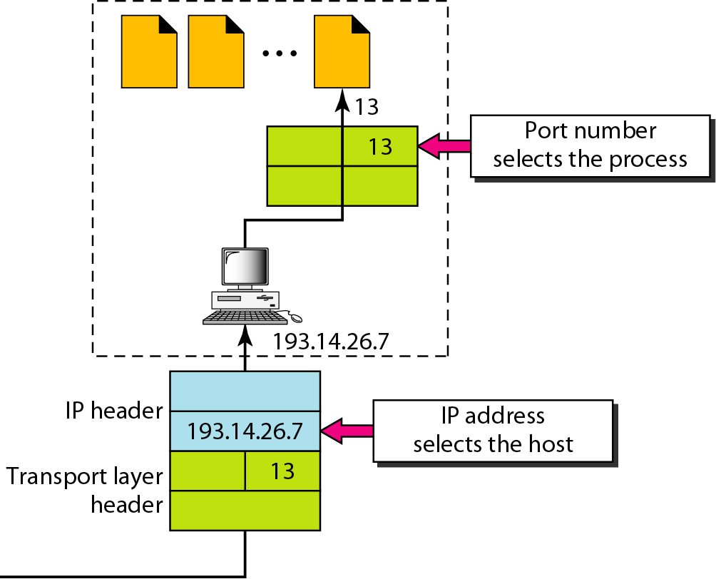
IP addresses versus port numbers

Slide 23
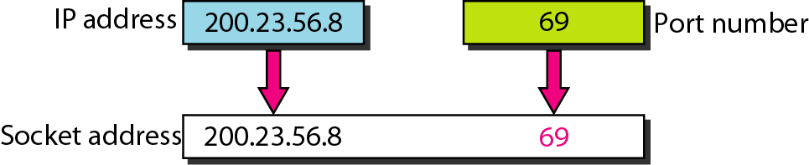
Socket Address

Slide 24
Sockets
The endpoints with buffers which applications use to communicate with each other
A socket has a unique address
IP Address
127.0.0.1 is the local host network – can use to send message to your peer on same node.
Port Number
You pass this address when you bind the socket.
In addition you must pass the network protocol being used when you create the socket.

Slide 25
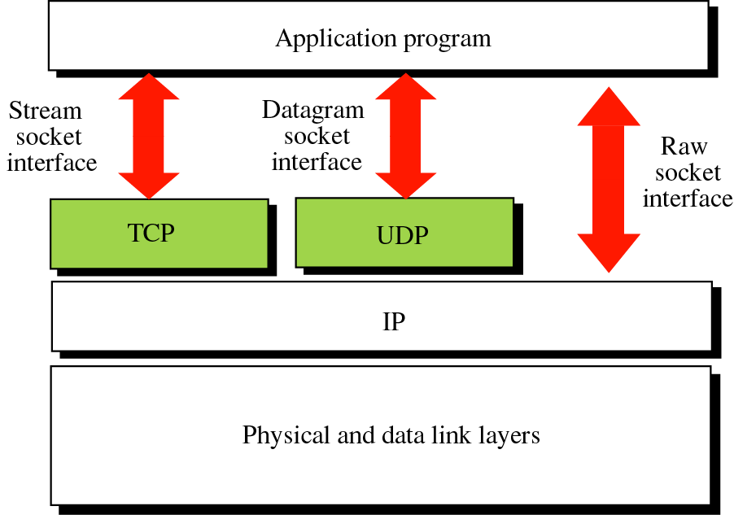
Socket Types

Slide 26
Datagram Socket: UDP
Client
1. Create transport
endpoint: socket()
1. Create transport
endpoint: socket()
2. Assign transport endpoint an address: bind()
2. Assign transport endpoint an address (optional): bind()
3. Determine address
of server
3. Wait for a packet
to arrive: recvfrom()
4. Formulate message
and send: sendto()
4. Formulate reply (if any)
and send: sendto()
5. Wait for packet
to arrive: recvfrom()
5. Release transport
endpoint: close()
6. Release transport
endpoint: close()
Server
Client

Slide 27
Socket Prototype
#include <netinet/in.h>
struct sockaddr_in {
short sin_family; // e.g. AF_INET
unsigned short sin_port; // e.g. htons(3490)
struct in_addr sin_addr; // IPv4 address
char sin_zero[8]; // zero this if you want to
};
struct in_addr {
unsigned long s_addr; // load with inet_aton()
};

Slide 28
Creating a Socket
int socket(int family,int type,int proto);
family specifies the protocol family (AF_INET for TCP/IP).
type specifies the type of service (SOCK_STREAM, SOCK_DGRAM).
protocol specifies the specific protocol (usually 0, which means the default).
The socket() system call returns a socket descriptor (small integer) or -1 on error.
socket() allocates resources needed for a communication endpoint
but it does not deal with endpoint addressing.

Slide 29
Assigning An IP to a Socket
The bind() system call is used to assign an address to an existing socket.
int bind( int sockfd, const struct sockaddr *myaddr, int addrlen);
bind returns 0 if successful or -1 on error.

Slide 30
Bind() Example
struct sockaddr_in myaddr;
int s;
myaddr.sin_family = AF_INET;
myaddr.sin_port = htons(3490);
// you can specify an IP address:
inet_aton("63.161.169.137", &myaddr.sin_addr.s_addr);
// or you can let it automatically select one:
myaddr.sin_addr.s_addr = INADDR_ANY;
s = socket(AF_INET, SOCK_STREAM, 0);
bind(s, (struct sockaddr*)myaddr, sizeof(myaddr));

Slide 31
UDP Socket System Calls
UDP Client
socket()
bind()
sendto()
recvfrom()
close()
UDP Server
socket()
bind()
recvfrom()
sendto()
close()
ssize_t sendto(int s, const void *buf, size_t len, int flags, const struct sockaddr *to, socklen_t tolen);
ssize_t recvfrom(int s, void *buf, size_t len, int flags,
struct sockaddr *from, socklen_t *fromlen);

Slide 32
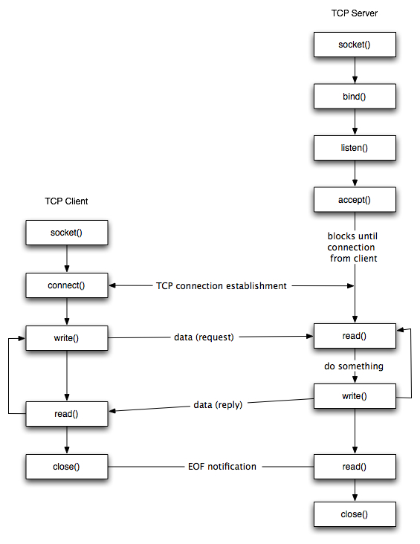
Stream Socket: TCP Socket API
int socket(int domain, int type, int protocol);
int bind(int s, const struct sockaddr *addr, socklen_t addrlen);
int listen(int s, int backlog);
int accept(int s, struct sockaddr *addr, socklen_t *addrlen);

Slide 33
Stream Socket: TCP Socket API
int socket(int domain, int type, int protocol);
int connect(int s, const struct sockaddr *name, socklen_t namelen);
Read and write are similar to the file operations.

Slide 34
TCP Socket System Calls
TCP Client
socket()
bind()
-
connect()
send()
receive()
TCP Server
socket()
bind()
listen()
accept()
receive()
send()

Slide 35
Socket Listen to connections (clients)
#include <sys/socket.h>
int listen(int s, int backlog);
Returns zero on success, or -1 on error (and errno will be set accordingly)
The backlog parameter tells how many pending connections we can have before the kernel starts rejecting new ones

Slide 36
Listen() Example
int s;
struct sockaddr_in myaddr;
myaddr.sin_family = AF_INET;
myaddr.sin_port = htons(3490); // clients connect to this port
myaddr.sin_addr.s_addr = INADDR_ANY; // auto select IP address
s = socket(PF_INET, SOCK_STREAM, 0);
bind(s, (struct sockaddr*)myaddr, sizeof(myaddr));
listen(s, 10); // set s up to be a server (listening) socket
// then have an accept() loop down here somewhere

Slide 37
Accepting Connection on Listening Socket
#include <sys/types.h>
#include <sys/socket.h>
int accept(int s, struct sockaddr *addr, socklen_t *addrlen);
accept() returns the newly connected socket descriptor, or -1 on error.

Slide 38
accept() Example
int s, s2;
struct sockaddr_in myaddr, remoteaddr;
socklen_t remoteaddr_len;
myaddr.sin_family = AF_INET;
myaddr.sin_port = htons(3490); // clients connect to this port
myaddr.sin_addr.s_addr = INADDR_ANY; // autoselect IP address
s = socket(PF_INET, SOCK_STREAM, 0);
bind(s, (struct sockaddr*)myaddr, sizeof(myaddr));
listen(s, 10); // set s up to be a server (listening) socket
for(;;) {
s2 = accept(s, &remoteaddr, &remoteaddr_len);
// now you can send() and recv() with the
// connected client via socket s2
}

Slide 39
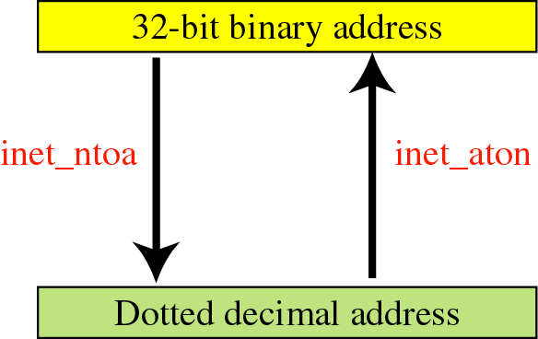
IPv4 Address Conversion
int inet_aton( char *, struct in_addr *);
Convert ASCII dotted-decimal IP address to network byte ordered 32 bit value.
Returns 1 on success, 0 on failure.
char *inet_ntoa(struct in_addr);
Convert network byte ordered value to ASCII dotted-decimal (a string).

Slide 40
IPv4 Address Conversion: Example
struct sockaddr_in ip-addr;
char *some_addr;
inet_aton("127.0.0.1", &ip-addr.sin_addr); // store IP in ip-addr
some_addr = inet_ntoa(ip-addr.sin_addr); // return the IP
printf("%s\n", some_addr); // prints "127.0.0.1"
// and this call is the same as the inet_aton() call, above:
ip-addr.sin_addr.s_addr = inet_addr("127.0.0.1");

Slide 41
Socket System Calls: Summary
Connection-oriented (TCP)
socket()
bind()
connect()
listen()
accept()
send()
recv()
Connectionless (UDP)
socket()
bind()
send()
recv()
General Use
read()
write()
close()

